Slide 1
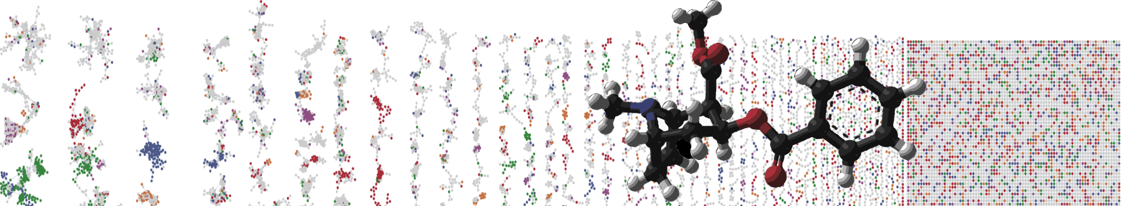


GNPS Molecular Networking Enhancer
Hands On
PRESENTER´S NAME
University of California - San Diego

Slide 2
MolNetEnhancer
Ernst et al., Metabolites 2019, 9(7), 144
Enhanced annotation!
Discover relevant
features!
Network
Annotation
Mining
https://github.com/madeleineernst/pyMolNetEnhancer
https://github.com/madeleineernst/RMolNetEnhancer

Slide 3
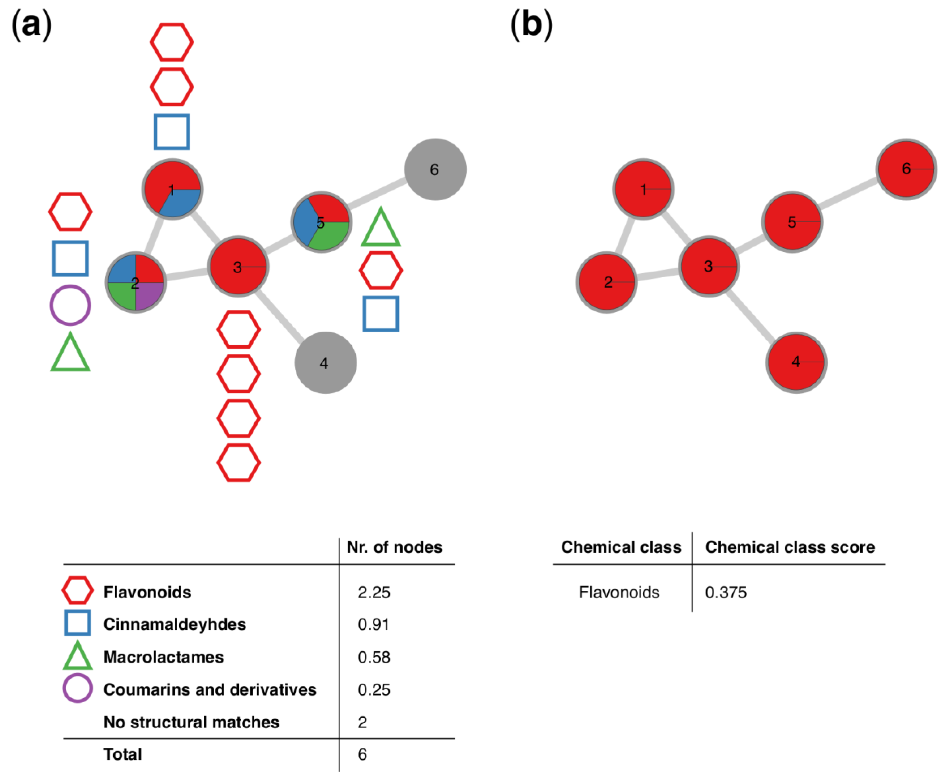
Schematic overview of how the chemical classification score
Ernst et al., Metabolites 2019, 9(7), 144
https://github.com/madeleineernst/pyMolNetEnhancer
https://github.com/madeleineernst/RMolNetEnhancer

Slide 4
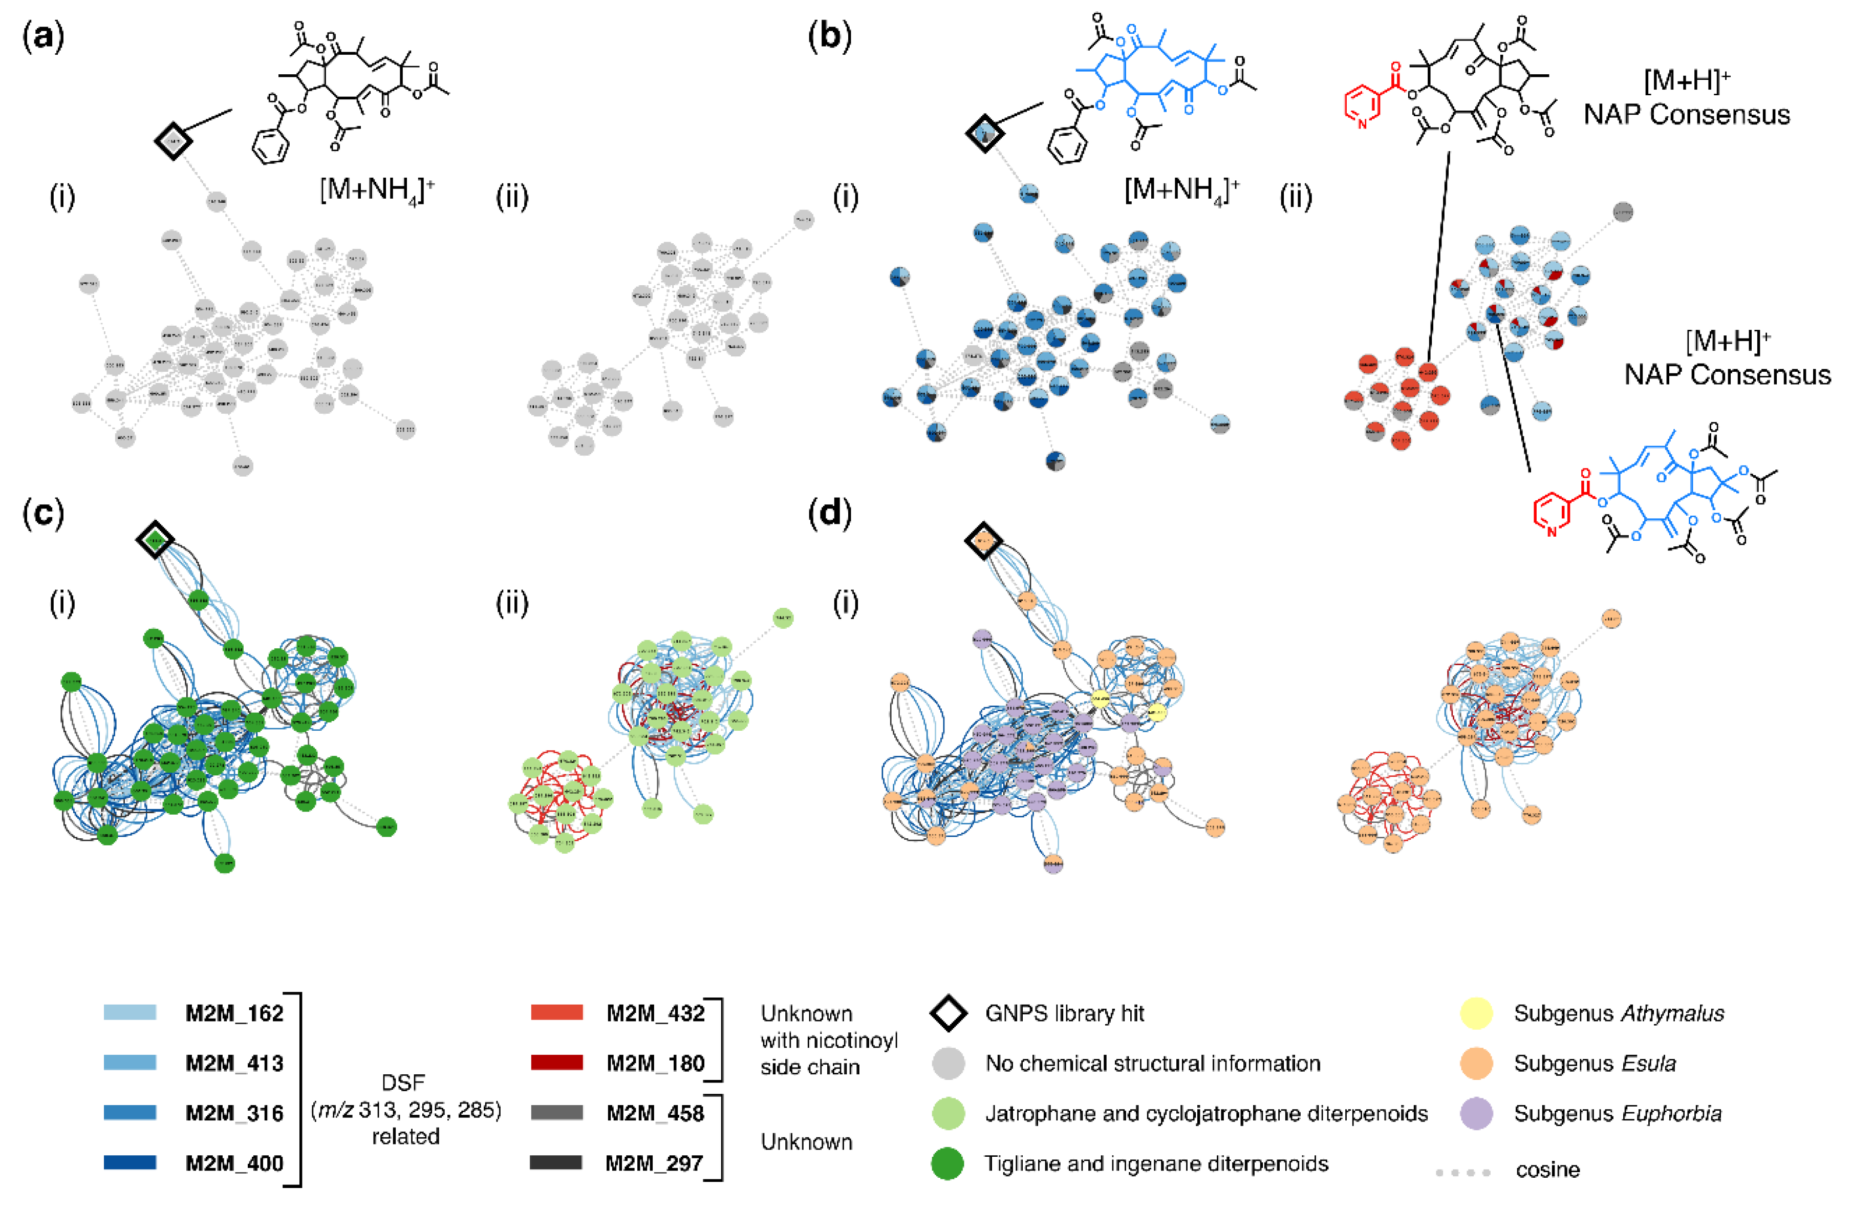
MolNetEnhancer increases chemical structural information obtained for Euphorbia specialized metabolites.
Ernst et al., Metabolites 2019, 9(7), 144
https://github.com/madeleineernst/pyMolNetEnhancer
https://github.com/madeleineernst/RMolNetEnhancer

Slide 5
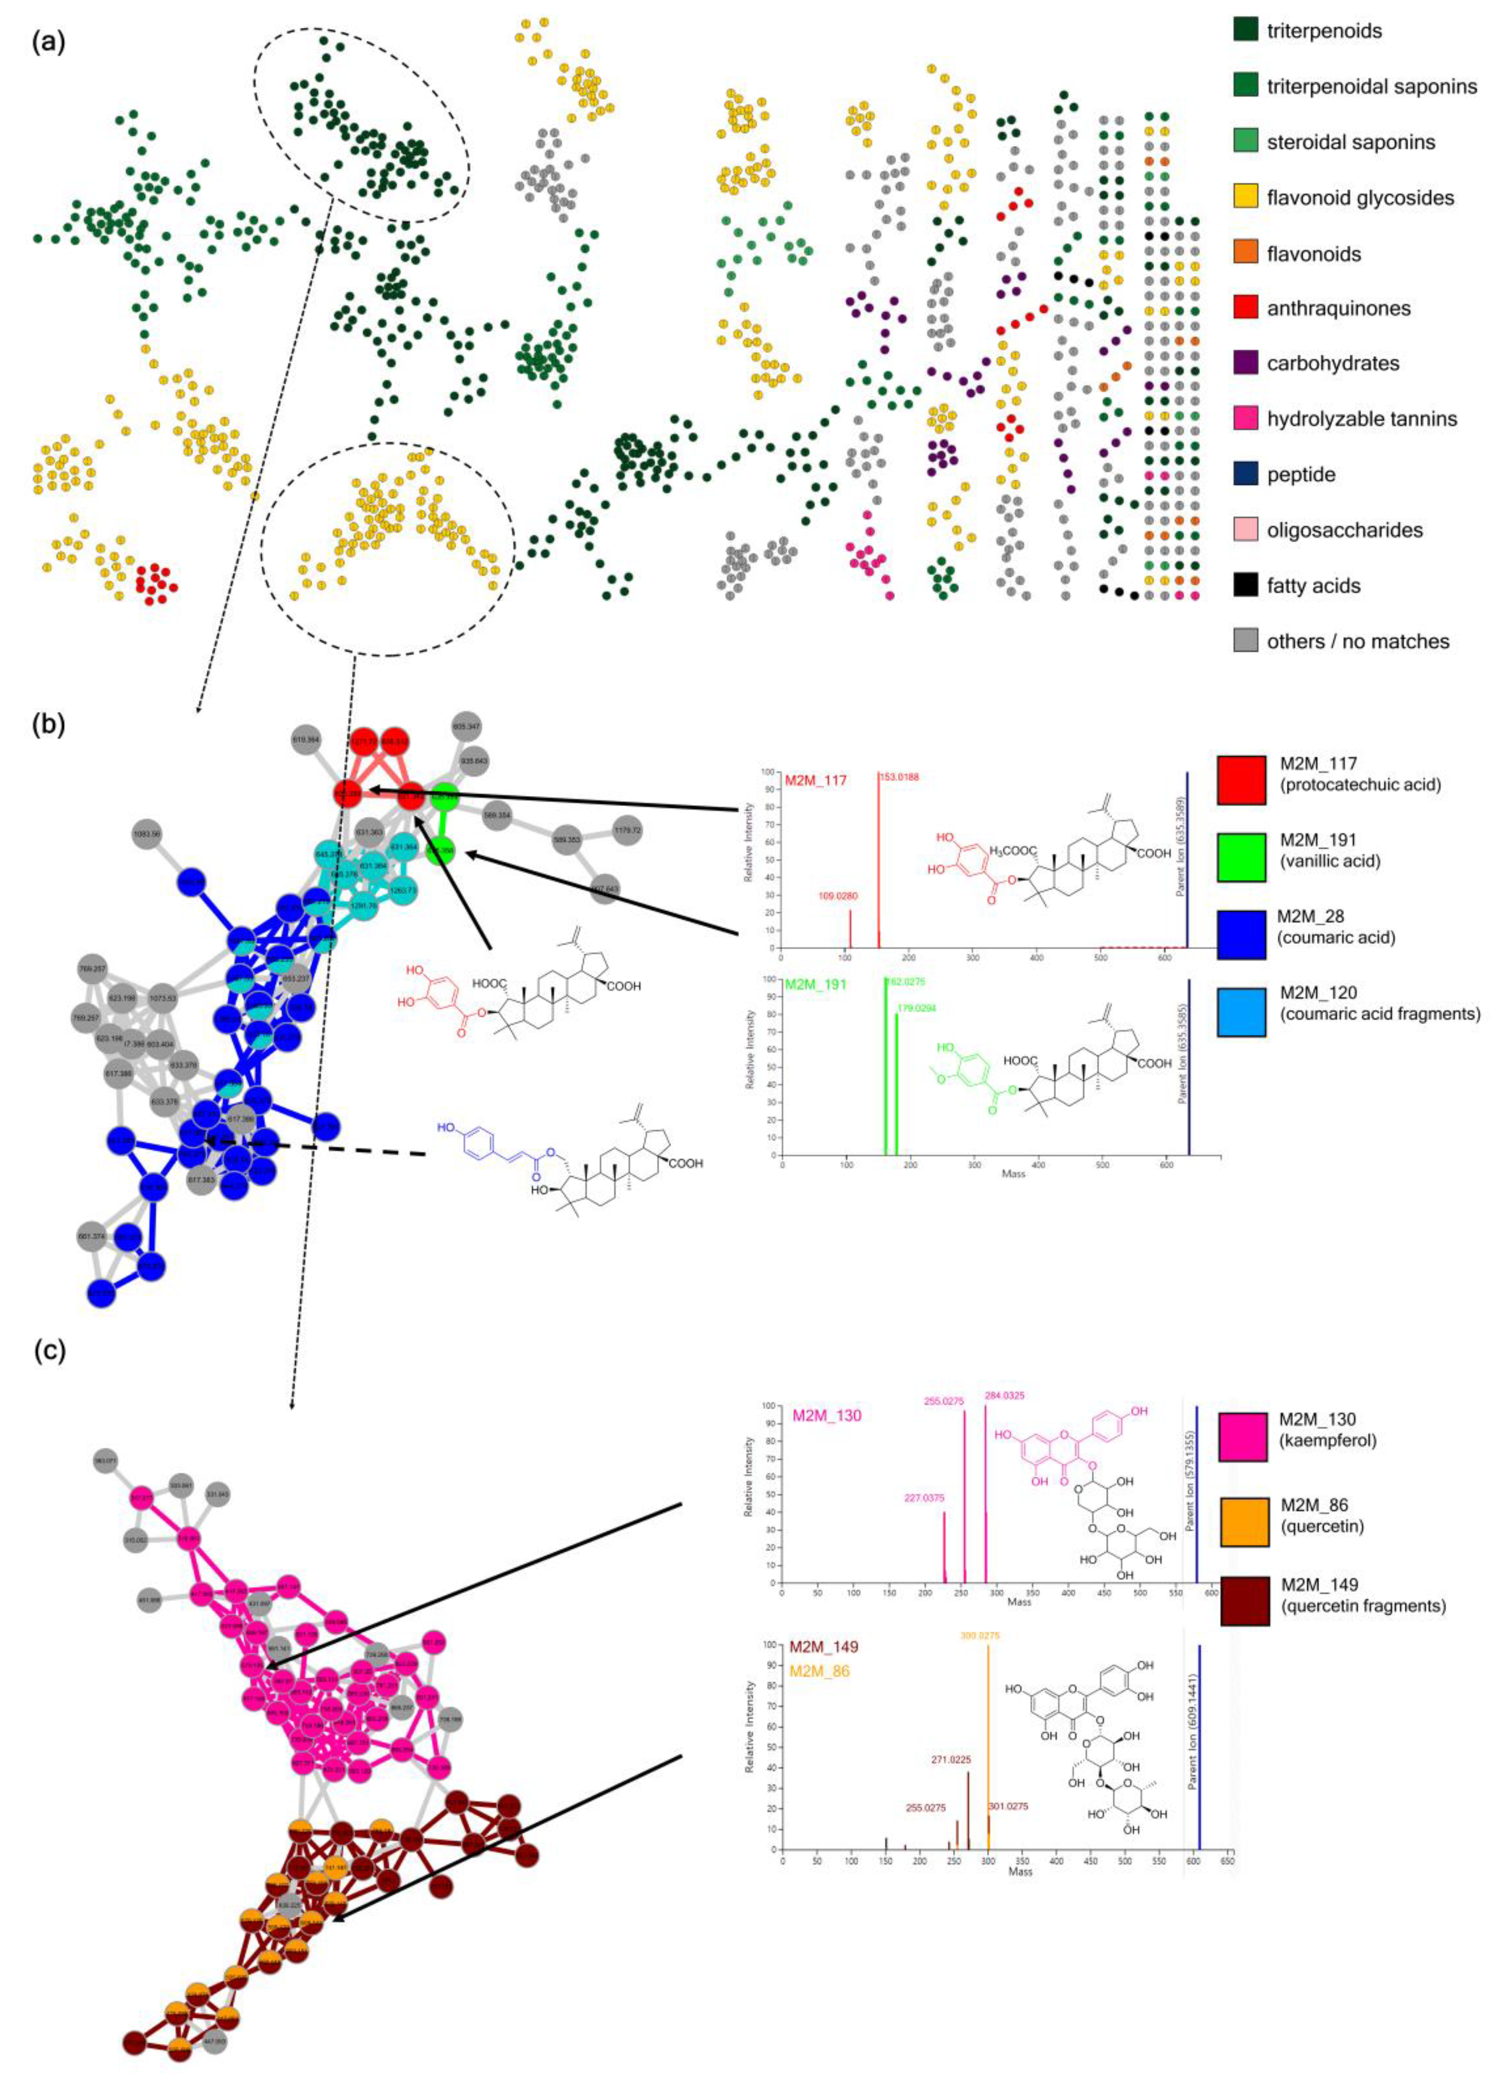
MolNetEnhancer increases chemical structural information obtained for Rhamnaceae specialized metabolites.
Ernst et al., Metabolites 2019, 9(7), 144
https://github.com/madeleineernst/pyMolNetEnhancer
https://github.com/madeleineernst/RMolNetEnhancer

Slide 6
MolNetEnhancer increases chemical structural information obtained for Rhamnaceae specialized metabolites.
Ernst et al., Metabolites 2019, 9(7), 144
https://github.com/madeleineernst/pyMolNetEnhancer
https://github.com/madeleineernst/RMolNetEnhancer

Slide 7
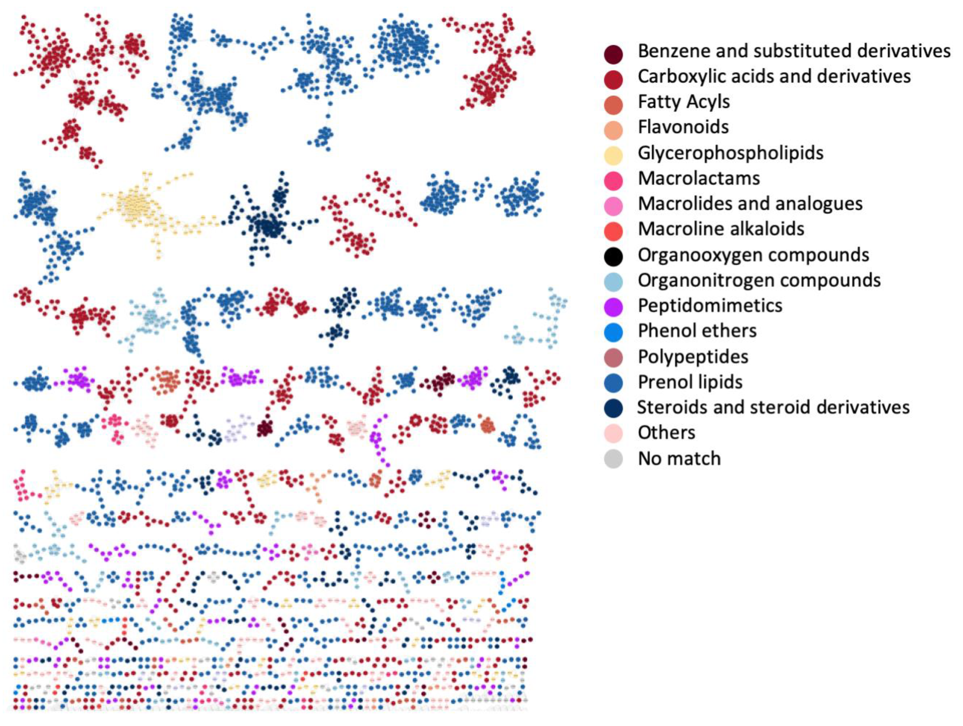
Chemical diversity of marine sediment Salinispora and Streptomyces
Ernst et al., Metabolites 2019, 9(7), 144
https://github.com/madeleineernst/pyMolNetEnhancer
https://github.com/madeleineernst/RMolNetEnhancer

Slide 8
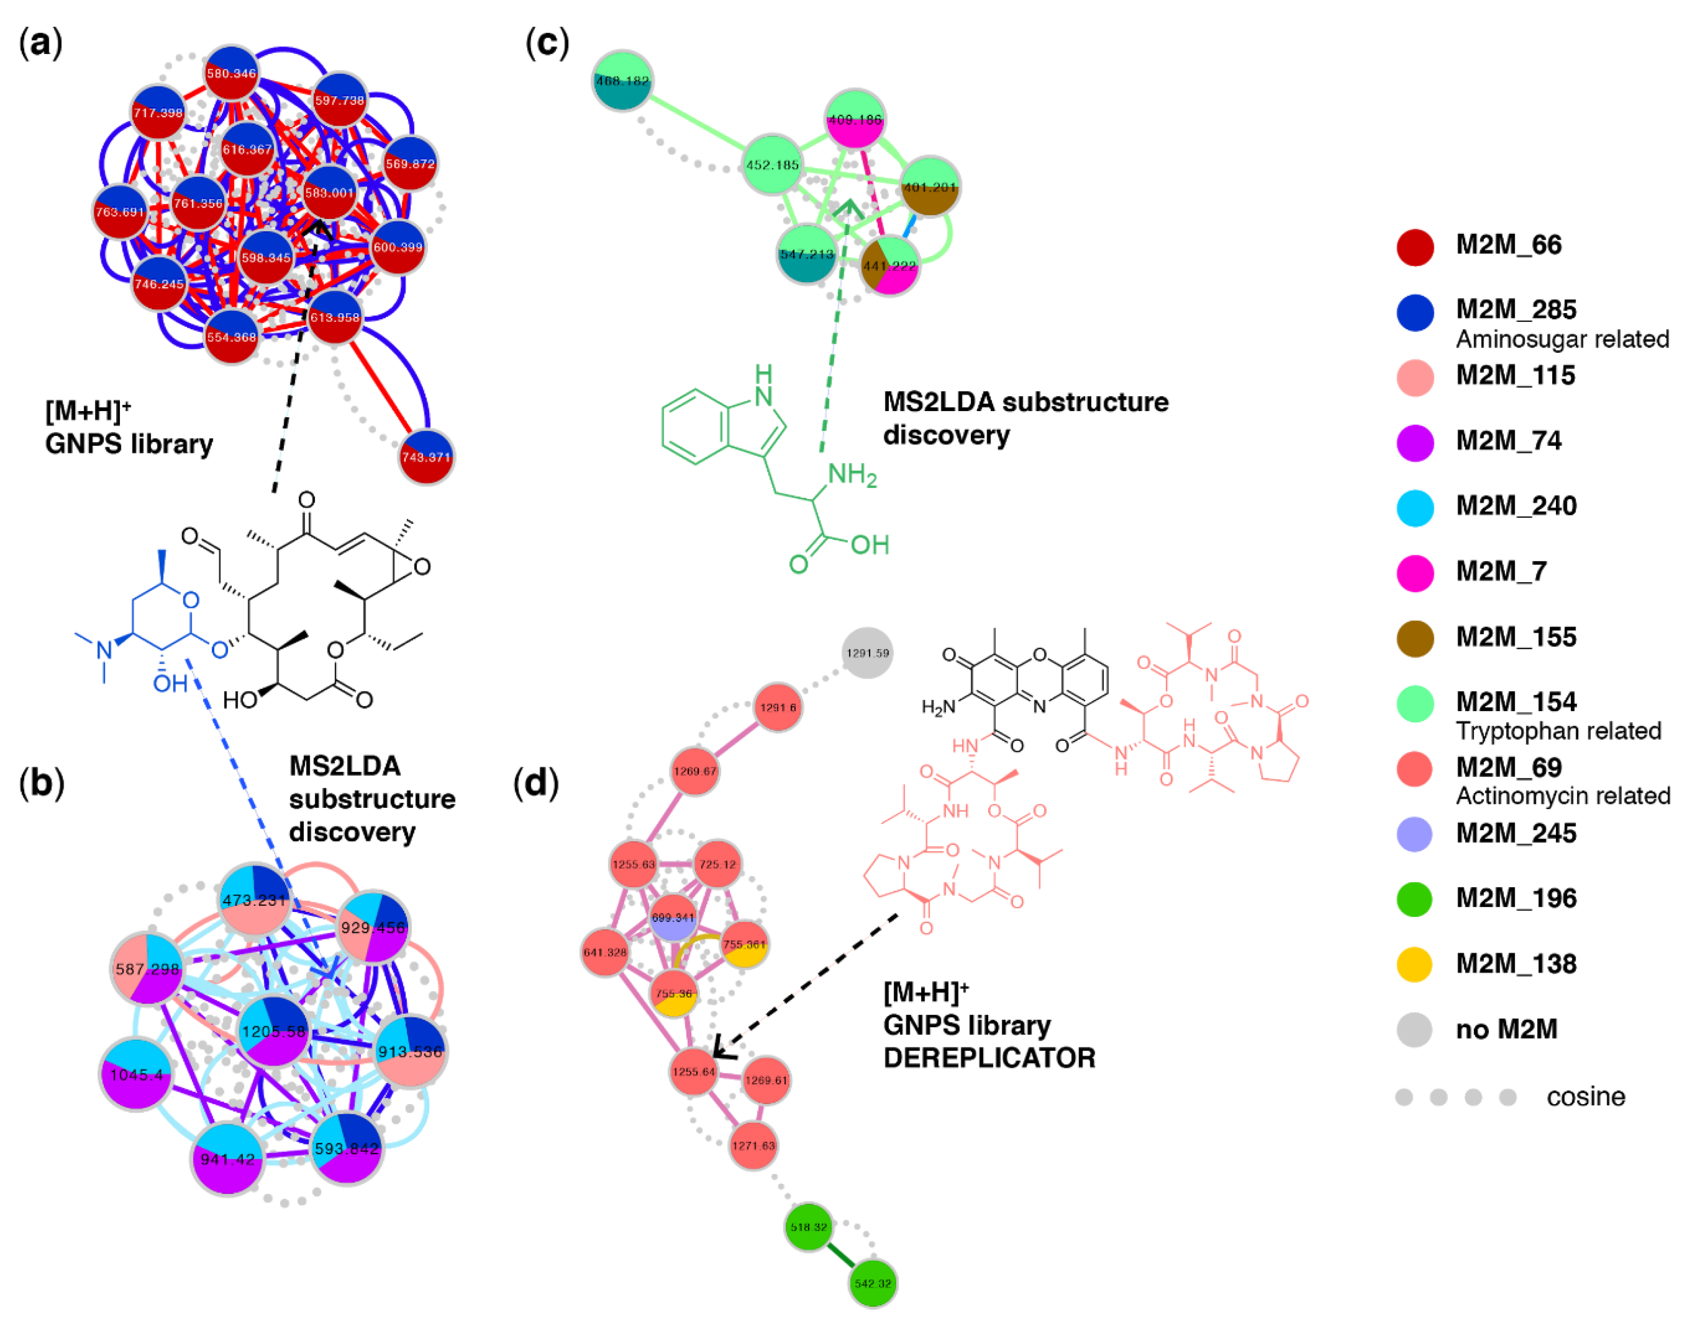
Chemical diversity of marine sediment Salinispora and Streptomyces
Ernst et al., Metabolites 2019, 9(7), 144
https://github.com/madeleineernst/pyMolNetEnhancer
https://github.com/madeleineernst/RMolNetEnhancer

Slide 9
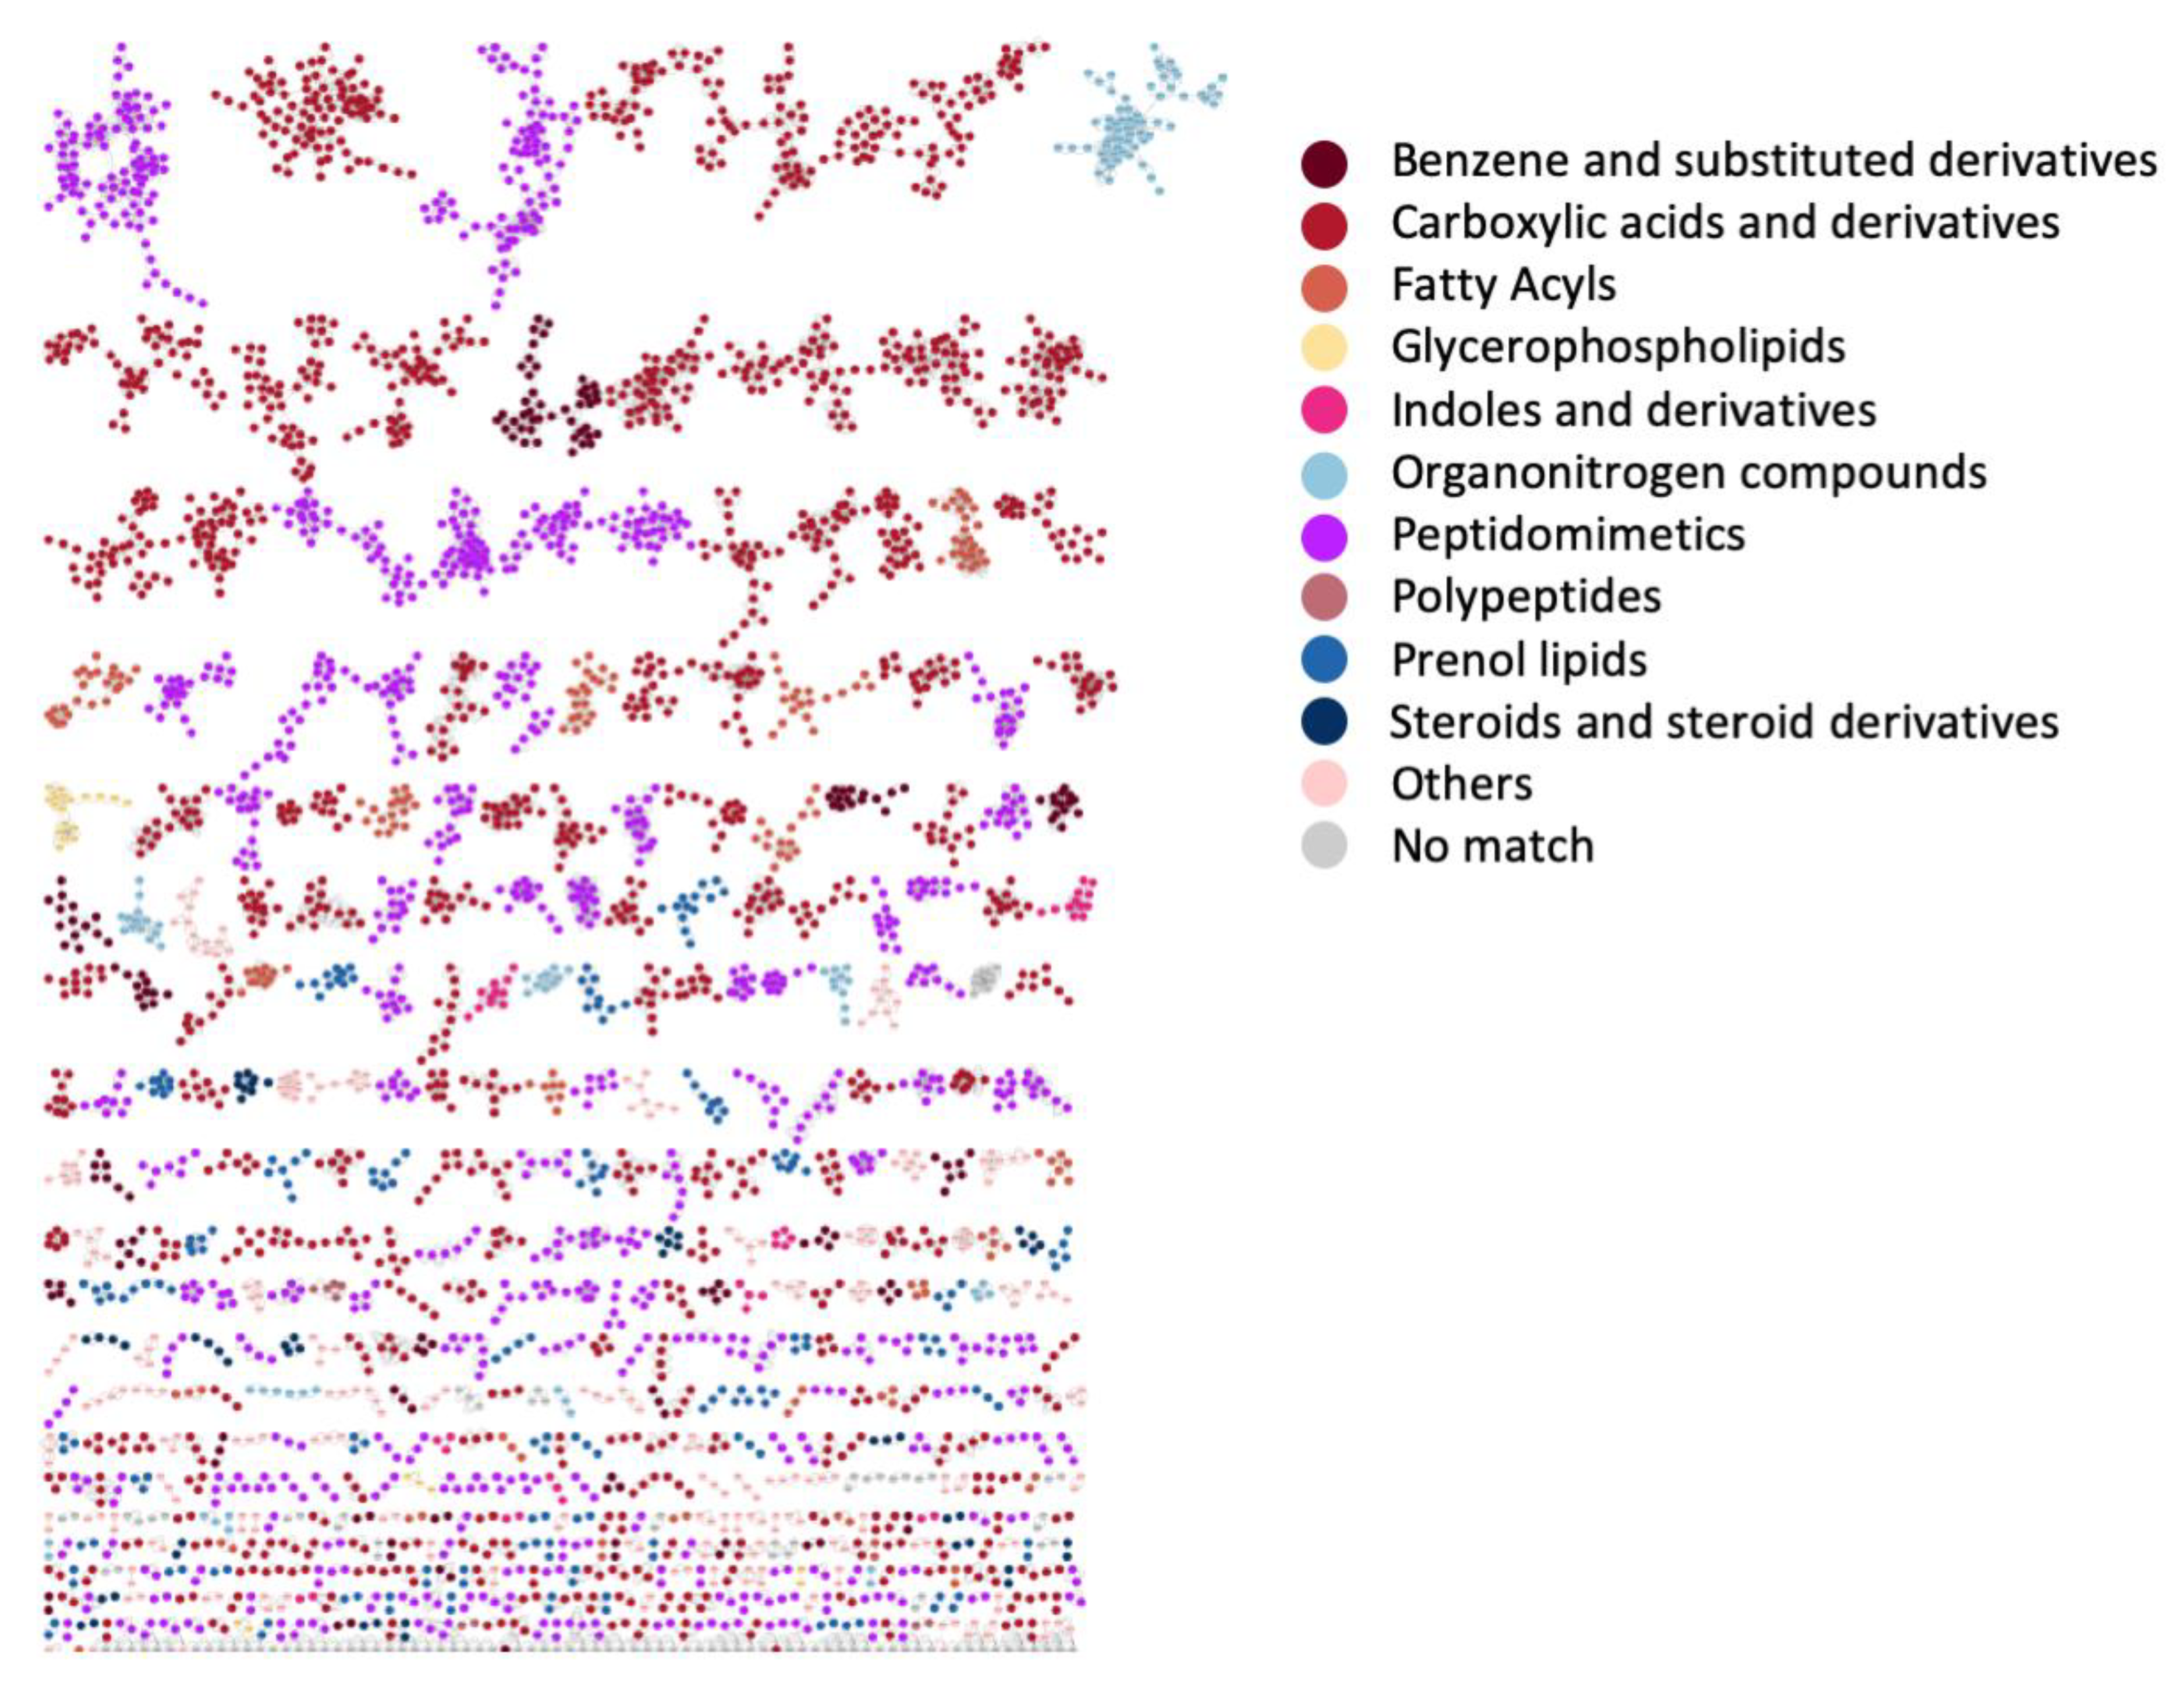
Chemical diversity of Nematode symbionts Photorhabdus and Xenorhabdus
Ernst et al., Metabolites 2019, 9(7), 144
https://github.com/madeleineernst/pyMolNetEnhancer
https://github.com/madeleineernst/RMolNetEnhancer

Slide 10
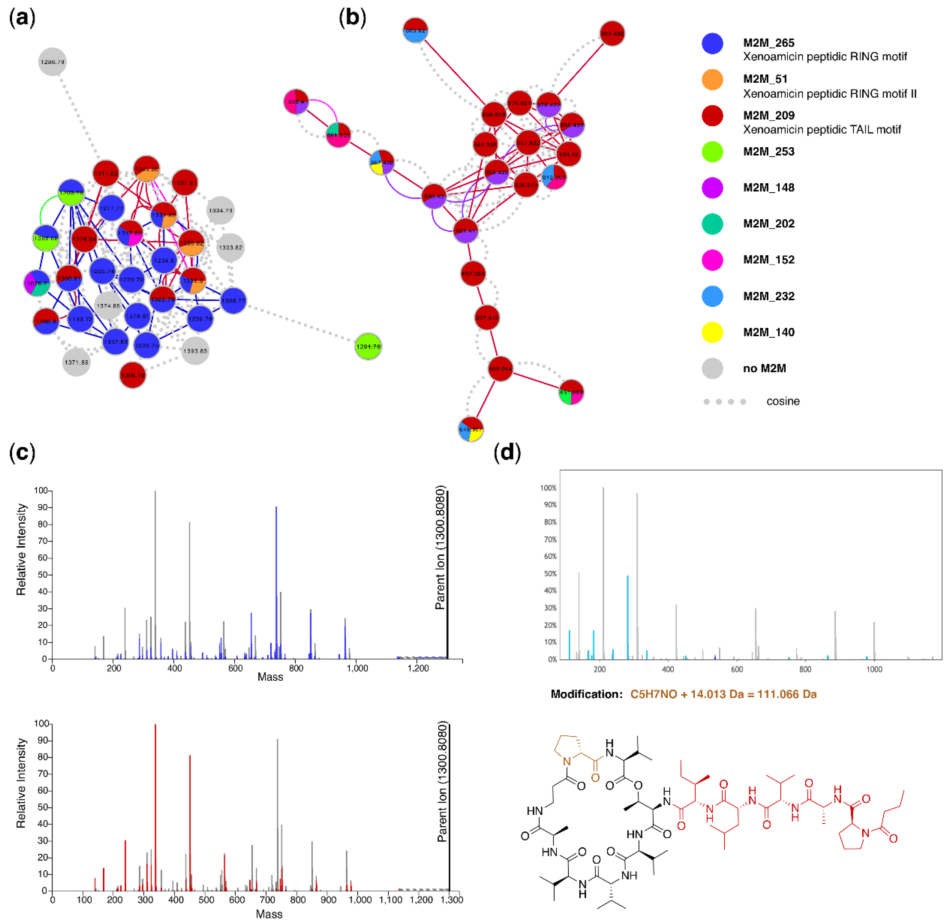
Xenoamicin-related molecular families annotated by MolNetEnhancer
Xenoamicin A spectrum in the ms2lda.org
Ernst et al., Metabolites 2019, 9(7), 144
https://github.com/madeleineernst/pyMolNetEnhancer
https://github.com/madeleineernst/RMolNetEnhancer

Slide 11
Xenoamicin-related molecular families annotated by MolNetEnhancer
Xenoamicin A spectrum in the ms2lda.org
VarQuest annotation of xenoamicin modified peptide where a proline indicated in brown is likely methylated.
Ernst et al., Metabolites 2019, 9(7), 144
https://github.com/madeleineernst/pyMolNetEnhancer
https://github.com/madeleineernst/RMolNetEnhancer

Slide 12
MolNetEnhancer
Ernst et al., Metabolites 2019, 9(7), 144
Tutorials to get familiar with individual tools from which the output is combined with MolNetEnhancer can be found here:
GNPS molecular networking:
https://ccms-ucsd.github.io/GNPSDocumentation/networking
DEREPLICATOR/VarQuest:
https://ccms-ucsd.github.io/GNPSDocumentation/dereplicator
Network annotation propagation:
https://ccms-ucsd.github.io/GNPSDocumentation/nap
ClassyFire:
http://classyfire.wishartlab.com
MS2LDA:
https://ccms-ucsd.github.io/GNPSDocumentation/ms2lda/
http://ms2lda.org/user_guide
MolNetEnhancer workflow tutorials in both R and Python can be found here:
https://github.com/madeleineernst/pyMolNetEnhancer
https://github.com/madeleineernst/RMolNetEnhancer

Slide 13
Questions, Problems or Bugs?
Documentation: https://ccms-ucsd.github.io/GNPSDocumentation/
Forum: https://groups.google.com/forum/#!forum/molecular_networking_bug_reports
PRESENTER´S NAME
Presenter´s e-mail

